Slide 1
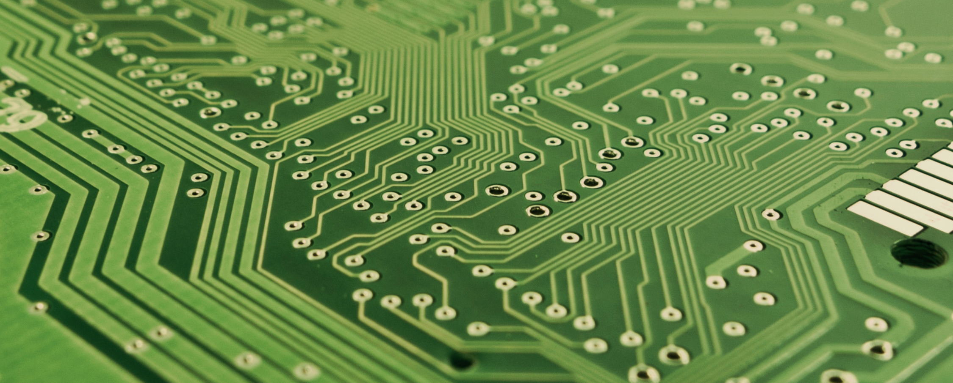
CryptoNote
Koral Hassan
Jorge Sanmiguel
Ricardo Vera
Vasil Zlatanov
The untraceable cryptocurrency protocol

Slide 2
Cryptocurrencies
How do they work?

Slide 3
Introduction
Public Key
Alice generates keys
Private Key

Slide 4
Use Private key to Sign Transaction
Transfer 10 coins from Alice to Bob
+

Slide 5
Public Key used to Verify
Transfer 10 coins from Alice to Bob
Verify
+

Slide 6
Double Signing Problem

Slide 7
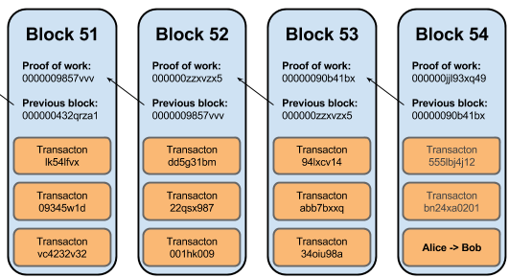
Solution: Blockchain
All transactions stored in a blockchain, avoids double spending
Network is programmed to accept longest blockchain
How do we stop people from rewriting?
Y. Brikman, Bitcoin Block Chain Verified. 2016
Notes:
All transactions stored in a blockchain, we can not repeat
Network is programmed to accept longest blockchain
How do we stop people from rewriting?

Slide 8
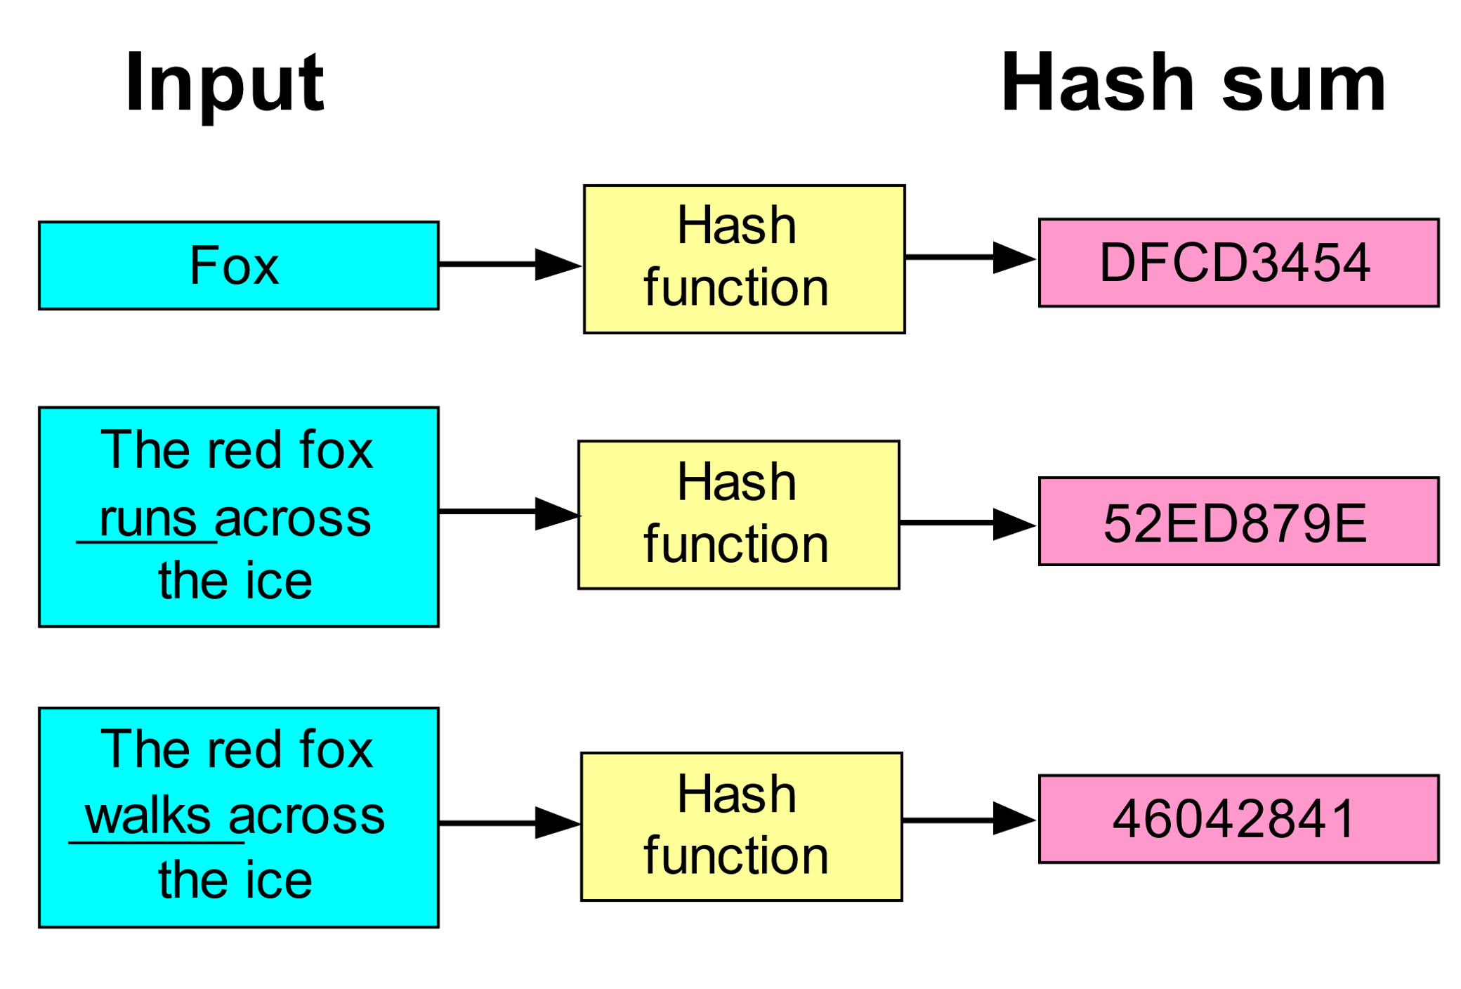
Hashing function
Notes:
One way – to find an input given the output we have to use brute computation

Slide 9
Proof of Work
Y. Brikman, Bitcoin Block Chain Verified. 2016
Notes:
All transactions stored in a blockchain, we can not repeat
Network is programmed to accept longest blockchain
How do we stop people from rewriting?

Slide 10
Use Private key to Sign Transaction

Slide 11
Public Key can be used to Verify

Slide 12
Double Signing Problem

Slide 13
Solution: Blockchain
All transactions stored in a blockchain, we can not repeat
Network is programmed to accept longest blockchain
How do we stop people from rewriting?

Slide 14
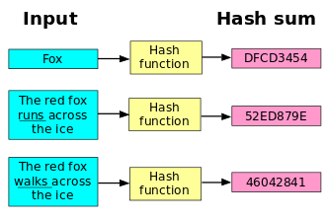
Hashing function
One way – to find an input given the output we have to use brute computation

Slide 15
Proof of Work

Slide 16
Problems
Hash function may lend itself to ASIC (double SHA-256), hindering network distribution
All transactions are known to everybody as they are stored in the blockchain
Many have profited from mixers/laundry services
Hardcoded parameters, cause forks
Irregular emission curve
Proof of work is bad for the environment (Not solved by CryptoNote)

Slide 17
Definitions
Untraceability: for each incoming transaction, all possible senders are equiprobable.
Unlinkability: for any two outgoing transactions, it is impossible to prove they were sent to the same person.
?
?
?

Slide 18
How CryptoNote works
Unlinkable and untraceable payments

Slide 19
Unlinkable Payment
Alice
Public
Bob
Base point: $G$ A prime $l$
1. Private user key
Public user key
$$(a,b)$$
2. Generate random $r$
$$(A,B)$$
$A=aG$ $B=bG$
a. One-Time Public Key
$$P=ℋ_{s}\left(rA\right)G+B$$
$$P$$
4. Check transaction
One-Time Private Key
b. Destination Key
$${x=ℋ}_{s}\left(aR\right)+b$$
$$R=rG$$
$$R$$
$${P^{′}=xG=P}_{s}$$
3. Send transaction
If genuine:
$$aR=arG=rA$$

Slide 20
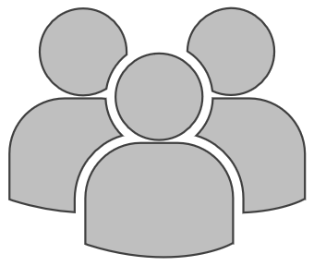
Verification: Ring Signatures
Group Signatures
Ring Signatures
Group Manager
Verifier
Alice
Group
Group
Group signatures: D. Chaum and E. Van Heyst
Ring signtaures: Rivest et al.
Traceable ring signature: Eiichiro Fujisaki and Koutarou Suzuki
Notes:
Ring signatures are digital signatures that can be executed by any member of a group.
Main feature -> unfeasible to determine who signed
Difference with group signatures are:
any group of users can be used as a group without additional setup
no way to revoke the anonymity of an individual signature
Ring signature used in CryptoNote is a variation of Traceable Ring Signatures, which reveal user after simultaneous signatures under same private key.

Slide 21
One time ring signature
Generates a set of public keys and a signature from an input message and a set of public keys.
Outputs if the signature is linked or independent from the set of existing (public) key images.
Generates an ecPair (P,x) and (public) key Image I, from public parameters.
Verifies the signature using the set of public keys.
GEN
SIG
VER
LNK

Slide 22
GEN
SIG
VER
LNK
Randomly generate private key $x$ and generate $P$ public key and $I$ key image.
PRIVATE
PUBLIC
$$P=xG$$
$$x ∈[1, l−1]$$
$$I=xℋ_{p}(P)$$

Slide 23
GEN
SIG
VER
LNK
Generate a one time ring signature with a non-interactive zero-knowledge proof.
P
$s$ is the index of $P (P_{s})$ in the set of public keys $S$ such that $0≤s≤n$.
P
$$L_{i}= \left\{ \begin{aligned}q_{i}G i ≠s \\ q_{i}G+w_{i}P_{i} i=s\end{aligned}\right.$$
Randomly pick $q_{i} (i=0,…,n)$ and $w_{i} (i=0,…,n;i≠s)$.
$$c= ℋ_{s}(m, L_{1}, …, L_{n}, R_{1}, …, R_{n})$$
$$R_{i}= \left\{\begin{aligned}{ q}_{i}ℋ_{p}(P_{i}) i ≠s \\ q_{i}ℋ_{p}(P_{i})+w_{i}I i=s\end{aligned}\right.$$
If the hash function is appropriate then the prover cannot guess its output before trying.

Slide 24
GEN
SIG
VER
LNK
Generate a one time ring signature with a non-interactive zero-knowledge proof.
$$r_{i}= \left\{ \begin{aligned}q_{i} i ≠s \\ {(q}_{i} −c_{s}x) mod l i=s\end{aligned}\right.$$
$$σ=(I, c_{1},…,c_{n}, r_{1},…, r_{n})$$
$$c_{i}= \left\{ \begin{aligned}w_{i} i ≠s \\ (c−\sum_{i}{c_{i})}mod l i =s\end{aligned}\right.$$
A signature is generated that provides no particular information about the user. Output of the algorithm is this signature and the set of public keys $S=S^{′ }∪ \{P_{s}\}$.
Applying L-transformations proves the signer knows $x$ such that $P_{i}=xG$.

Slide 25
GEN
SIG
VER
LNK
Perform inverse $L$ and $R$ transformations from $r_{i}$ and $c_{i}$, in order to replicate $c$ via the hashing function.
$$\left\{ \begin{aligned}L_{i}^{′}=r_{i}G+c_{i}P_{i} \\ R_{i}^{′}=r_{i}ℋ_{p}\left(P_{i}\right)+c_{i}I\end{aligned}\right.$$
The signature proves the user is part of the group without giving any information of the user.
$$c^{′}= ℋ_{s}(m, L_{0}^{′},…, L_{n}^{′},R_{0}^{′}, …, R_{n}^{′})$$
$$\sum_{i=0}^{n}{c_{i}= ℋ_{s}\left(m,L_{0}^{′},…,L_{n}^{′},R_{0}^{′},…,R_{n}^{′}\right)mod l}$$

Slide 26
GEN
SIG
VER
LNK
Avoid repeatable signature using key image $I$ and set $𝔗$ of observed signatures.
I
I
I
+
If $I$ is in $𝔗$ the signature is linked to a user hence preventing the use of repeated signatures and preserving the ‘one-time’ nature of the key.
The signer knows $x$ such that at least one $ℋ_{p}\left(P_{i}\right)=I x^{−1}$, proving he knows the signature is non-repeatable.

Slide 27
CryptoNote - Summary
One Time Public Key has associated One time Address (OTA)
Scan the blockchain for OTA's which belong to you
132bba
8Coins
df57ee
100 Coins
c9ad38
5 Coins
249a02
7Coins
be1d4b
2 Coins
c8b2ca8
1 Coin
Total:
13 Coins

Slide 28
CryptoNote - Summary
Generate new OTA for the recipient, from their P
Use one of your OTA's to send to recipient's OTA
Your OTA is hidden among the group
Cannot use your OTA again without revealing it
Transfer 10 coins
From several possible OTA to OTA
Recipient verifies transaction is for them
+
Ring Signature
(Untraceable)

Slide 29
Further Considerations

Slide 30
Egalitarian Proof-of-work
Bitcoin
CryptoNote
Uses the CPU-intensive SHA-256.
Memory-intensive pricing function
Saving memory requires increasing calculation speed exponentially
No parallelism, N simultaneous threads require N times more memory
Notes:
*Makes ASICS possible
-------
*“functions whose computation time is dominated by the time spent accessing memory”

Slide 31
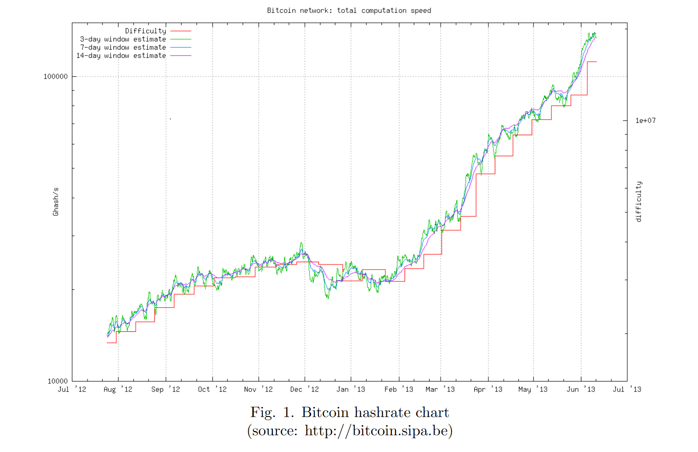
Smooth Emission Curve
Bitcoin
CryptoNote
Predetermined amount per block
$BaseReward = \left(MSupply – A\right),$
where A is amount of previously generated coins and
$$MSupply = 264−1$$
Notes:
* Each solved block went from 50 to 25 BTC
* Vulnerable to double spend attack

Slide 32
Adjustable parameters
Bitcoin
CryptoNote
Hard-coded limits.
Difficulty α sum all the work completed by the nodes and divide it by the time they have spent.
Block size and excess size penalty α median block size
Notes:
*block size changed in wallet version 0.8 and ended with a 24-blocks chain split
and a successful double-spend attack. Bug was not in Bitcoin protocol, but in database engine. it could have been easily caught by a simple stress test if there was
no artificially introduced block size limit.
-----

